Slide 1
Exploiting Local Feature Patterns for Unsupervised Domain Adaptation
(Draft)
Jun Wen, Nenggan Zheng, Qian Zheng, Junsong Yuan
Zhejiang University & University at Buffalo
Nov 12, 2018

Slide 2
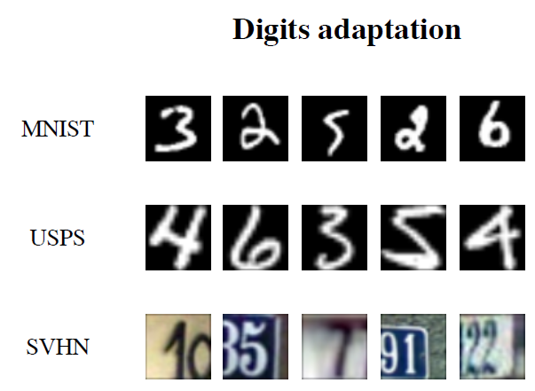
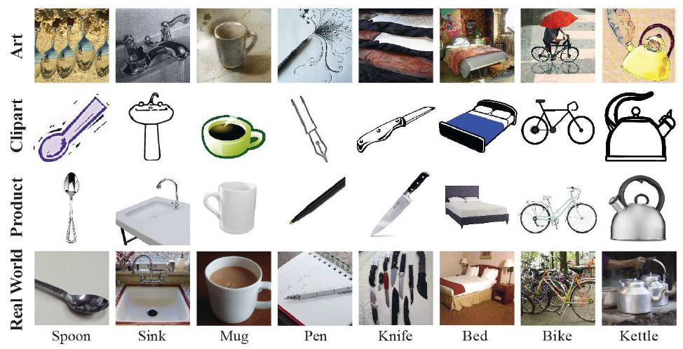
Unsupervised Domain Adaptation
Source Domain: labeled data;
Target Domain: unlabeled (or few labels)
Objective: learn features from source labels that can be applied to target

Slide 3
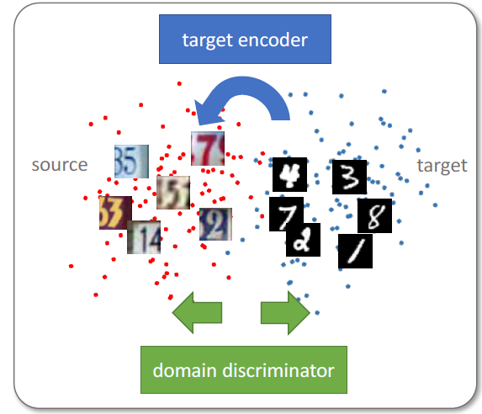

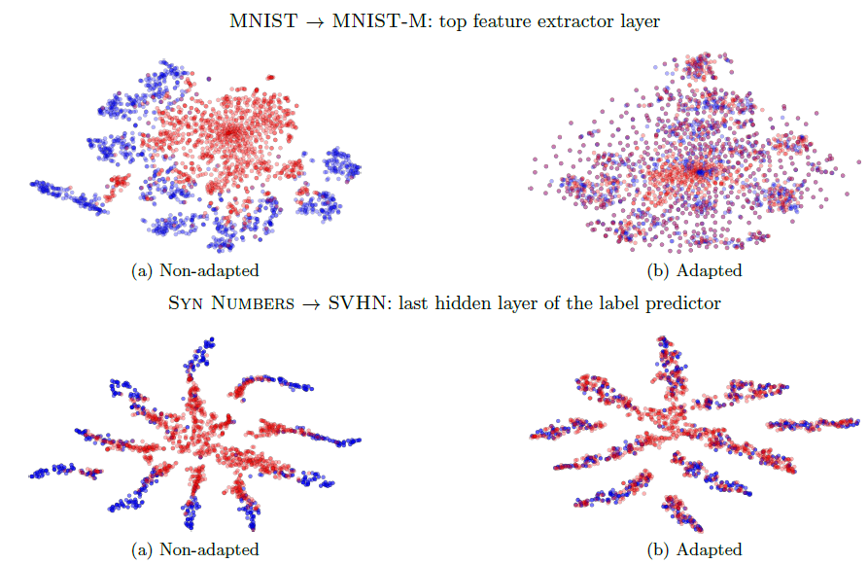

Domain-invariant Features
Two properties of representation:
Discriminative for both domains: classification objective;
Domain invariant: adaptation objective;
[1] A theory of learning from different domains, ICML 2009.
[2] Domain-Adversarial Training of Neural Networks, ICML 2016.

Slide 4
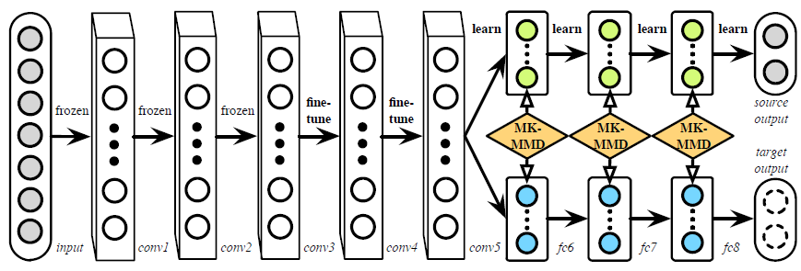
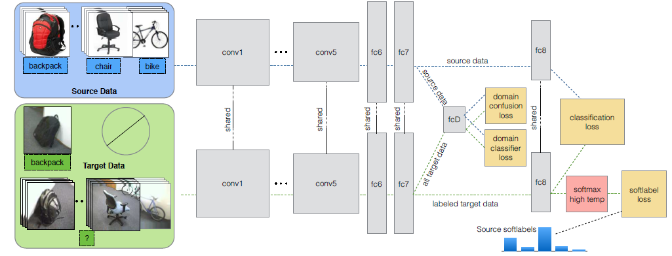

Divergence Metrics
1) Maximum Mean Discrepancy (MMD) in RKHS space
2) Adversarial learning
[1] Simultaneous Deep Transfer Across domains and tasks, ICCV2015;
[2] Learning Transferable Features with Deep Adaptation Network, ICML 2015.

Slide 5
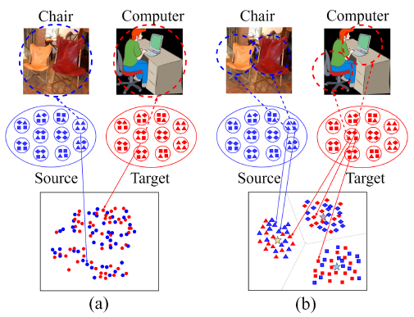
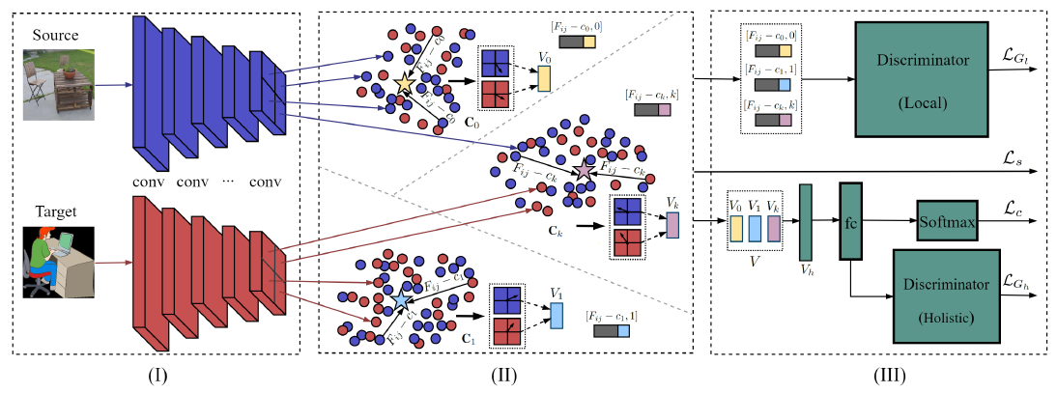
Holistic and Local Alignment
Holistic alignment:
holistic features easily overfit source labels;
no consideration of complex local feature distributions;
Local alignment:
local features are more generic and transferable;
respect the multi-mode statistics of local features;

Slide 6
Method Overview
Three components:
Feature extractor G: multiple convolution layers (VGG16 is used in the paper);
Local patterns learning: employ the NetVLAD for local feature aggregation;
Feature alignment: jointly aligning holistic and local features based on adversarial learning;

Slide 7
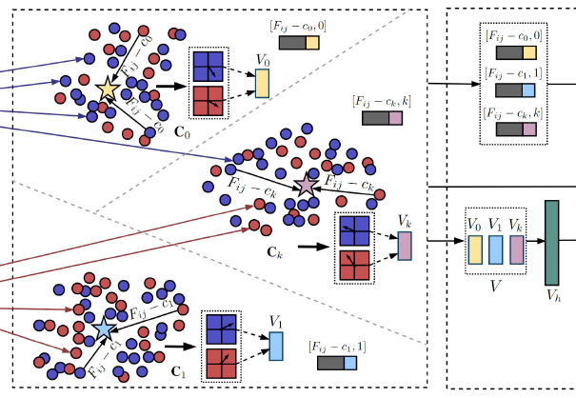
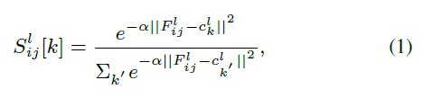

Local Feature Patterns Learning
Two learning steps:
initialize the local patterns using K-means over local features;
end-to-end training;
To components:
similarity vector:
local feature aggregation:

Slide 8
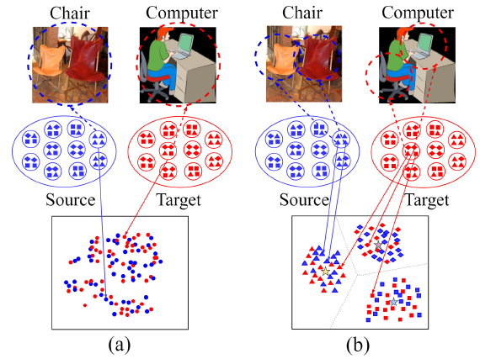
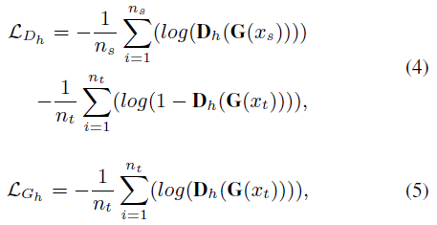
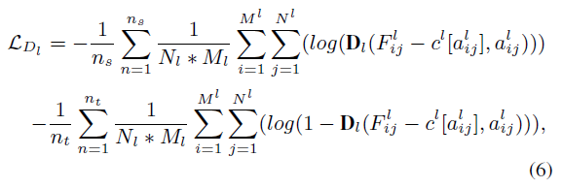
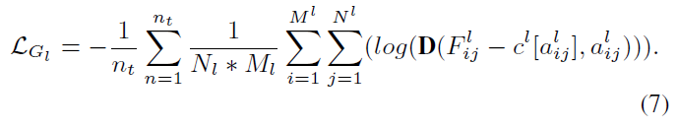
Feature Alignment
1) Holistic alignment: classifier activations
2) Local alignment: residuals of convolution layer activations

Slide 9
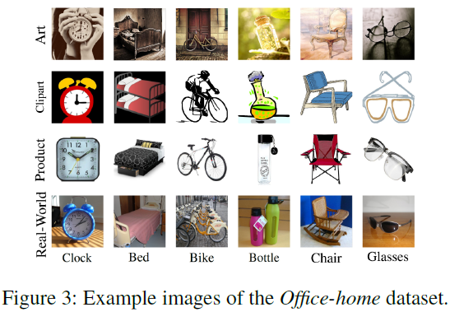
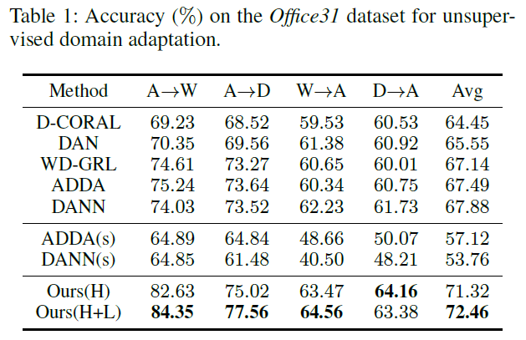
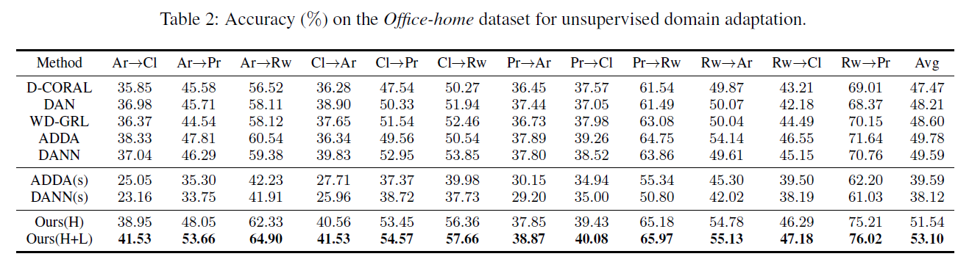
Experiments
Datasets:
1) Office 31: most popular;
2) Office-home: very challenging;
Settings:
Ours(H): only holistic alignment;
Ours (H+L): joint alignment;
ADDS(s): randomly initialized fully-connected layers with smaller size.

Slide 10
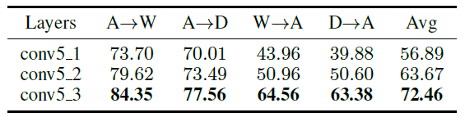
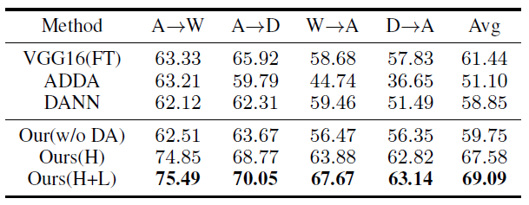

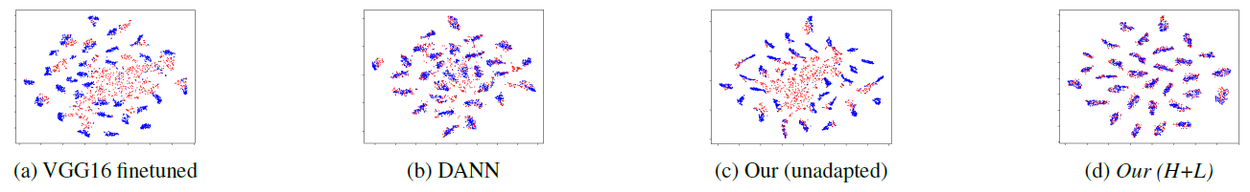
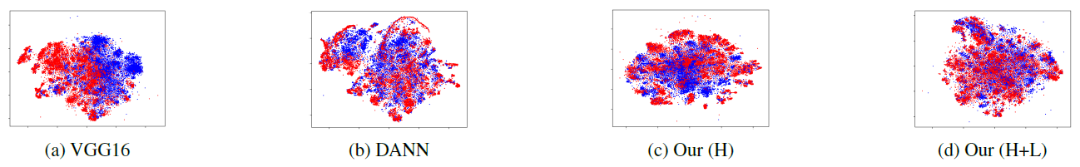
Experiments-Ablation Study
Negative transfer with 31-25 tasks:
Different layers:
Number of K:
Holistic
alignment:
Local
alignment:

Slide 11
Conclusions
A novel unsupervised domain adaptation approach by exploiting local feature patterns;
We showed local feature patterns:
more generic and transferable;
enable fine-grained feature alignment;
alleviate negative transfer;

Slide 12
Thank you!

